Slide 1

C Programming
05: Loop structure

Slide 2
Recap
Last week
Introduced three structure in program: sequence, selection, loop
Introduced the selection structure and conditional statements.
This week
looping statements

Slide 3
Question
calculate the sum of 1-10
s=1+2+3+4+5+6+7+8+9+10
printf(“%d”,s);
calculate the sum of 1-100
s=?

Slide 4
Loop structure
1
2
Definition of loop structure
While loop
Do while loop
3
4
For loop

Slide 5
Definition of loop structure
The Merriam-Webster dictionary defines a loop as
“a series of instructions (as for a computer) that is repeated until a terminating condition is reached.”

Slide 6
Definition of loop structure
Iteration and Repetition
Loop Condition
The loop condition indicates when the loop should repeat. If the condition is true, the loop will repeat its block of statements. Otherwise, the loop will terminate.
The terms iteration and repetition describe the repeated execution of a block of statements. A repetition or iteration structure is a loop statement. It repeats a block of statements once, multiple times or not at all..

Slide 7
While Loops
The most basic type of loop
Repeats a statement while a condition is true
Syntax
while (condition)
statement；
Statement is almost always compound

Slide 8
While Loop
A while loop is a control flow statement that allows code to be executed repeatedly based on a given condition.
The while construct consists of a block of code and a condition/expression. The condition/expression is evaluated, and if it is true, the code within the block is executed. This repeats until the condition/ expression becomes false.
Because the while loop checks the condition/expression before the block is executed, the control structure is often also known as a pre-test loop.

Slide 9
While Loop
In a pre-test loop, the condition is tested first. If the condition is true, the block of statements is executed. Then the condition is checked again
F
condition
T
statements

Slide 10
While Loop
while (expression) <statements>
F
k<n
F
expression
T
T
statements
s=s+k
while (k<n) s=s+k;

Slide 11
While Loop
【 ex.1】compute s=1+2+3+…+n (n≥1) and output the result.
s=0 , k=1
s=0;k=1;
Input n
scanf(“%d”,&n);
F
k<=n
while(k<=n)
{s=s+k; k=k+1;}
T
s=s+k
k=k+1
printf(“%d”,s);
Output s

Slide 12
While Loop
#include "stdio.h"
main()
{ int s,k,n;
s=0;k=1;
scanf(“%d”,&n);
while(k<=n) {s=s+k; k=k+1; }
printf("s=%d\n",s);
}

Slide 13
While Loop
Analysis
Assume n=5
initial: k=1;s=0;
k | Loop times | s
1 | 1 | s=0+1=1
2 | 2 | s=1+2=3
3 | 3 | s=3+3=6
4 | 4 | s=6+4=10
5 | 5 | s=10+5=15
6 | Loop over
s=0 , k=1
Input n
F
k<=n
T
result：
Input: 6↙
Output:
s=15
s=s+k
k=k+1
Output s

Slide 14
While Example
Question: how to calculate the factorial of the variable a ?
fact = 1;
fact = fact * 2;
fact = fact * 3;
...
fact = fact * a;
long fact;
int num, i;

Slide 15
While Example
while ( i <= num )

Slide 16
While Example
#include <stdio.h>
int main()
{ int i, num;
long fact;
num = 10;
/* What number do we want to calculate the factorial of? */

Slide 17
While Example
/* Initialise the factorial */
fact = 1;
/* Count from 2 to num, multiply fact by counter each time */
i = 2;
while ( i <= num ) {
fact = fact * i;
i = i + 1;
}
/* Print the result */
printf(“The factorial of %d is %ld\n”, num, fact);
}

Slide 18
While & Do Loops
If the condition is false, nothing executes
What if you want it to execute at least once?
We shift the test to the bottom of the loop
And get what is called a do loop
syntax
do <statements > while (expression)

Slide 19
Do while Loop
A do while loop is a control flow statement
that executes a block of code at least once, and then repeatedly executes the block, or not, depending on a given boolean condition at the end of the block.
Because do while loops check the condition after the block is executed, the control structure is often also known as a post-test loop.

Slide 20
Do while Loop
In a post-test loop, the loop condition is tested at the end. That means that the block of statements is executed first, then the loop condition is checked. Thus, the post-test loop always guarantees that the block of statements is executed at least once.
statements
condition
T
F

Slide 21
Do while Loop
do <statements > while (expression)
s=s+k
statements
k<=n
T
expression
T
F
F
do s=s+k; while (k<=n);

Slide 22
Do while Loop
【 ex.2】compute s=1+2+3+…+n (n≥1) and output the result.
s=0;k=1;
s=0 , k=1
scanf(“%d”,&n);
Input n
s=s+k
k=k+1
do{s=s+k; k=k+1;}
while(k<=n);
k<=n
T
F
printf(“%d”,s);
Output s

Slide 23
Do while Loop
#include "stdio.h"
int main() {
int s,k,n;
s=0;k=1;
scanf(“%d”,&n);
do {s=s+k; k=k+1; }
while(k<=n);
printf("s=%d\n",s);
return 0;
}
result：
Input: 6
Output:
s=15

Slide 24
Do while Loop
#include "stdio.h"
main() {
int s,k,n;
s=0;k=1;
scanf(“%d”,&n);
do {s=s+k; k=k+1; }
while(k<n);
printf("s=%d\n",s);
}
Question?

Slide 25
For Loops
One type of loop is very common:
Repeating a fixed number of times
Often iterating through arrays
We can do this with a while loop
But there’s a special form of loop called for

Slide 26
For Loop
Syntax:
for([expression 1];[expression 2];[expression 3]) statements;
syntactic sugar
it could be de-sugared into a while loop

Slide 27
Repeating With While
int i = 0; //initial value
while(i < num) //condition
{
…
i++; //increment
}

Slide 28
Equivalent For Loop
Initial Value
Condition
Increment
for(i = 0;i < num; i++)
{
…
}

Slide 29
For Loops
Some languages only allow for loops to count
C allows you to do anything you want:
for (initial; condition; increment)
statement;
The three control expressions in a for loop are:
initial executes before the loop starts
condition is tested at top of the loop
increment executes at bottom of the loop

Slide 30
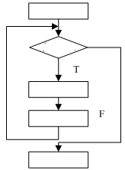
for (initial; condition; increment)
statement;
initial
condition
statements
increment
statements

Slide 31
For Loop
Syntax:
for([expression 1];[expression 2];[expression 3]) statements;
Ex. for(i=1;i<=9;i++) printf("%d ",i);
initialization statement
Exp1
i=1;
conditional expression
F
Exp2
i<=9;
T
Statements
printf("%d ",i);
increment/decrament statement
Exp3
i++；

Slide 32
For Loop
【 Ex. 】 s=1+2+3+…+n (n≥1)
#include "stdio.h"
main()
{ int s,k,n;
scanf("%d",&n);
s=0;
k=1;
while(k<=n) {s+=k; k++; }
printf("s=%d\n",s);
}
initialization
conditional expression
Loop body
increment/decrament statement
for(k=1;k<=n;k++) s+=k；

Slide 33
For Loop
#include "stdio.h"
void main()
{ int s,k,n;
printf("Input n=");scanf("%d",&n);
s=0;
for(k=1;k<=n;k++) s+=k;
printf("s=%d\n",s);
}

Slide 34
For Loop
Ex. calculate sum of all odd numbers within 1000.
#include "stdio.h"
void main()
{ long s=0;int k;
for(k=1;k<1000;k+=2) s+=k;
printf("s=%ld\n",s);
}

Slide 35
Other usages
the initial is omitted
i=1;
for( ; i<=n; i++)
s=s*i;
the condition is omitted
for(i=1; ; i++)
s=s*i;
the increment is omitted
for(i=1; i<=n; )
{ s=s*i;
i++;
}

Slide 36
Classic For Loop Error
int x, y;
for (x = 0; x < 11; x++);
y++;
y only increments once!
int x, y;
for (x = 0; x < 11; x++)
{ // for loop
y++;
} // for loop
int x, y;
for (x = 0; x < 11; x++)
y++;

Slide 37
Problems
If the condition never changes, what happens?
It runs for ever
In an infinite loop
And there is no way the compiler can check it!
So it is the programmer’s responsibility
How do you avoid it?

Slide 38
The Infinite Loop
A loop becomes an infinite loop if a condition never becomes false.
The for loop is traditionally used for this purpose. Since none of the three expressions that form the 'for' loop are required, you can make an endless loop by leaving the conditional expression empty.
for( ; ; )…;
while(1)…;

Slide 39
Avoiding Infinite Loops
Make sure you have a clear condition
Make sure you always set the condition
Make sure you use '==' instead of '='
Put in print statements for debugging
Learn how to kill a runaway process
e.g. with Ctrl-C at the command line

Slide 40
How Does it Work?
The condition is tested first
At the top of the loop
If false, we jump past the entire loop
If true, the (compound) statement executes
When we hit the bottom of the loop
We go to the top of the loop

Slide 41
Generic Control Flow
When one statement is complete
We move to the next one
I.e. we proceed in strictly linear sequence
What is the most general possible solution?
Allow us to jump to another piece of code
This is known as goto
but this doesn’t solve our problem

Slide 42
Nesting
Just as if/else statements may be nested, loops may also be nested. Similarly, loops follow exactly the same rules no matter how they are nested.
In fact, if/else statements and loops may be nested within each other in any combinations. The rules are always the same regardless of any combinations or depths of nesting.

Slide 43
Nesting
printf(“*”)
*
* *
* * *
* * * *
* * * * *
printf(“**”)
printf(“***”)
printf(“****”)
printf(“*****”)
How to output a triangle with 100 rows?

Slide 44
Nesting
Row | output
1 | output 1 * ，output new line
2 | output 2 * ，output new line
3 | output 3 * ，output new line
4 | output 4 * ，output new line
5 | output 5 * ，output new line
*
* *
* * *
* * * *
* * * * *

Slide 45
Nesting
Solution:
For each row, there are m asterisks and a new line.
m = i
*
* *
* * *
* * * *
* * * * *

Slide 46
Nesting
*
* *
* * *
* * * *
* * * * *
外层循环变量i每变化一次，
内层循环j变化一轮
for(i=1;i<=5;i++)
{
}
{ for(j=1;j<=i;j++) putchar(‘*’);
printf("\n");
}

Slide 47
Nesting
for(i=1;i<=5;i++)
{ for(j=1;j<=i;j++) putchar(‘*’);
printf("\n");
}
}
i | j
1 | 1
2 | 1 |  |  |  |  | 2
3 | 1 |  |  | 2 |  |  |  | 3
4 | 1 |  | 2 |  |  | 3 |  |  | 4
5 | 1 | 2 |  |  | 3 |  | 4 |  |  | 5
1 1
*
2 1 2
* *
3 1 2 3
4 1 2 3 4
* * *
5 1 2 3 4 5
* * * *
i=6 loop terminated
* * * * *
47

Slide 48
Limited Versions
You are allowed to use:
return;
goto the end of the function
break;
goto out of the current loop
continue;
goto the bottom of the loop

Slide 49
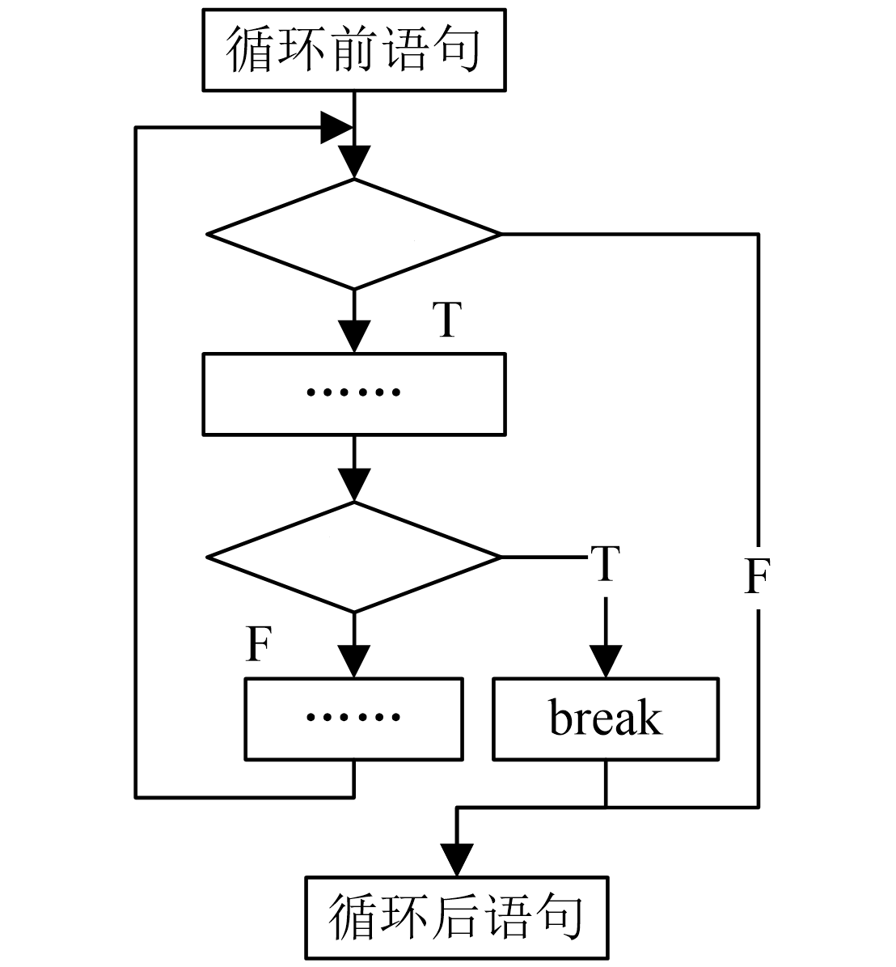
Break
while(condition 1)
{ ......
if (condition 2)
break;
......
}
staments
staments
staments
c1
c1
c2
c2
staments
staments

Slide 50
Ex. S=1+2+3+···+n。 （n≥1）
……
int s=0, i=1;
while(1) {
s+=i;i++;
if(i>n) break;
}
printf("s=%d\n",s);

Slide 51
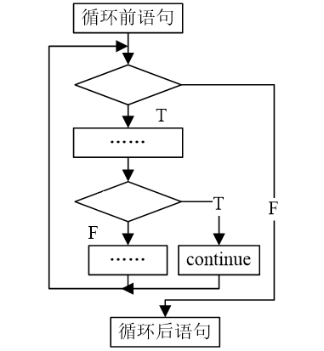
Continue
while(condition 1)
{ ......
if (condition 2)
continue;
......
}
staments
c1
c2
staments

Slide 52
Example
for(i=1;i<100;i++)
{ if(i%3!=0) continue;
printf("%5d",i);
}
for(i=1;i<100;i++)
{ if(i%3!=0) break;
printf("%5d",i);
}

Slide 53
Summarize
Loop structure let programs execute a series of instructions that is repeated until a terminating condition is reached.
The pre-test and post-test structures provide different ways to do this.

Slide 54

Exercises
1.output a character triangle with 5 rows
2.Input 5 scores, calculate the average score and output the result.
* * * * *
* * * *
* * *
* *
*

